Slide 1

An analysis on violence enhancing factors
Presentation & Analysis by: Elias Kalach Salame, Marco Buratti, Marec Reifert and Roberto Semeraro

Slide 2
Agenda
Introduction to our analysis and preliminary work
Questions & addressed stakeholders
Description of the analyzed dataset
Preliminary work on the dataset
Limitations
Analysis and main results
Development of violent incidents across all states
Principal-Component-Analysis (PCA)
Cluster-Analysis
Conclusion

Slide 3

1.: Introduction to our analysis and preliminary work

Slide 4
1.1.: Questions & addressed Stakeholders
How did violence develop over the years?
Does the impact of the analyzed factors differ between states?
Have the violence rates been affected by a change in gun law?
US Government (Legislative branch)
Federal level (e.g. Congress)
State level (e.g. Governors)
Law enforcement
E.g. police
Judicial branch
E.g. Supreme Court
News & Media

Slide 5
1.2.: Description of the analyzed dataset
Dataset contains data on 51 US states collected between 1977-1999
Consisting of 1173 observations on 13 variables (see next slide for the explanation)
Source: https://vincentarelbundock.github.io/Rdatasets/csv/AER/Guns.csv (accessed on 21.10.2020)

Slide 6
Explanation and format of observed variables
State (fact): factor indicating observed state
Year (fact): factor indicating observed year
Violent (num): violent crime rate (incidents per 100.000 members of population)
Murder (num): murder rate (incidents per 100.000 members of population)
Robbery (num): robbery rate (incidents per 100.000 members of population)
Prisoners (num): incarceration rate in the state in the previous year (sentenced prisoners per 100,000 residents)
Cauc (num): percentage of Caucasian state population (age: 10 – 64)
Afam (num): percentage of African-American state population (age: 10 – 64)
Male (num): percentage of male state population (age: 10-29)
Population (num): population of state in millions
Income (num): real per capita personal income (in US-Dollar)
Density (num): population per square mile of land area divided by 1000
Law (fact): factor indicating if state has a shall carry law in effect in observed year

Slide 7
1.3.: Preliminary work on the dataset
Removed features „Murder“ and „Robbery“ from the dataset as we focused on the impact on violence and had concerns about potential intersections
Created sub-datasets focusing on whether a gun law had been in place or not
Furthermore, it enables us to standardize data by excluding the binary feature „law“
Reduced the number of analyzed data entries to facilitate computation and to avoid altering the interpretation of the feature “law” as a binary feature

Slide 8
1.4.: Limitations
Data was collected by a third party
Outdated dataset
Lack of information on features, such as: “murder”, ”robbery” or “law”
Our own preliminary work on the dataset

Slide 9

2.: Analysis and main results

Slide 10
2.1.: Development of violent incidents across all states

Slide 11
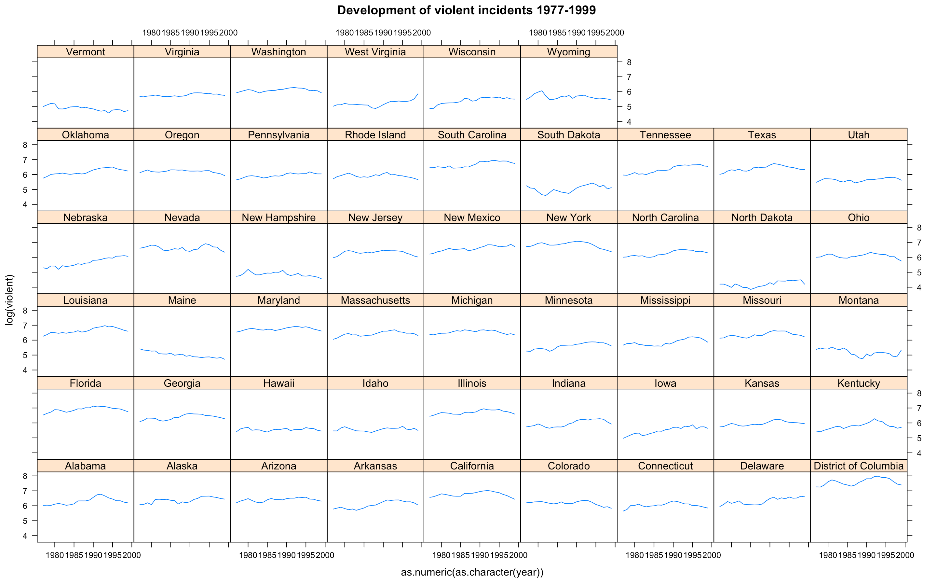
2.1.: Overview of crime development across all states
Figure 1

Slide 12
2.2.: Principal-Component-Analysis (PCA)

Slide 13
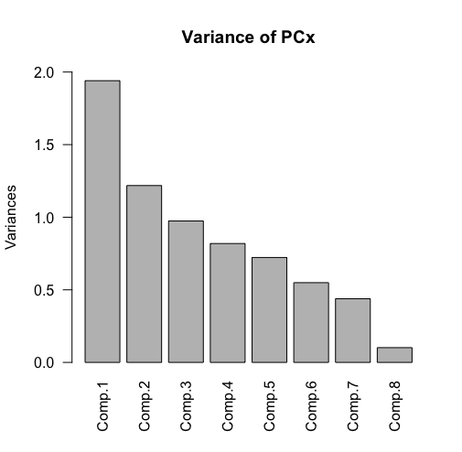
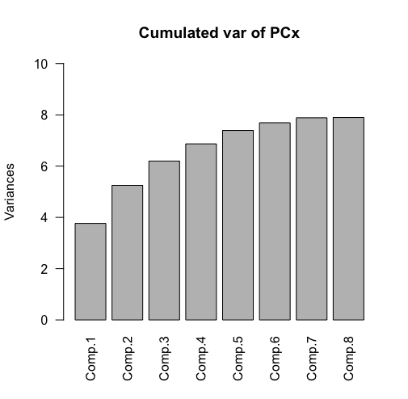
Variance & cumulated variance of PCs
Figure 2
Figure 3

Slide 14
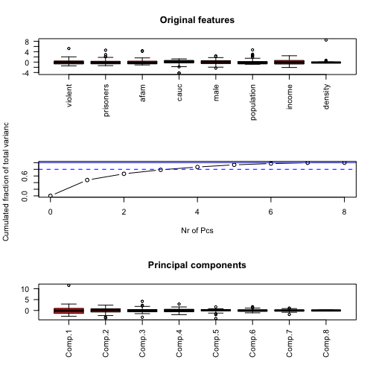
Figure 4
Plot 2 shows that 3 features cover around 80% of the total variance
Plot 3 shows that starting from the fourth component the number of outliers are higher than in first three components

Slide 15
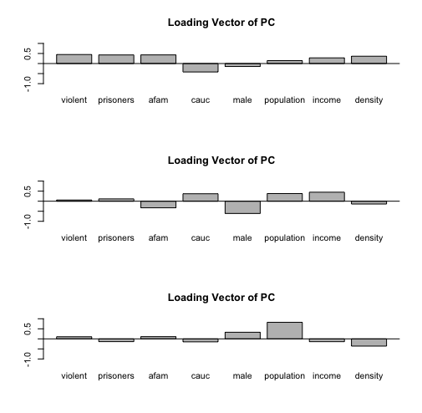
Figure 5
Representation of chosen main loading vectors
Vector 1: Afam, prisoners and violence are highly correlated, it amounts to 47% of the proportion
Vector 2 shows income, population and Caucasian are highly correlated

Slide 16
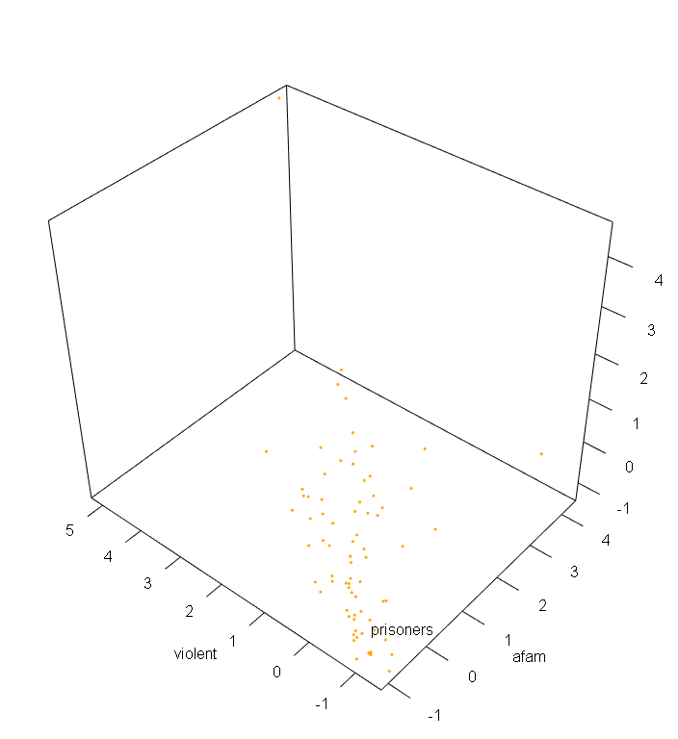
3D depiction of PCA 1
Figure 6

Slide 17
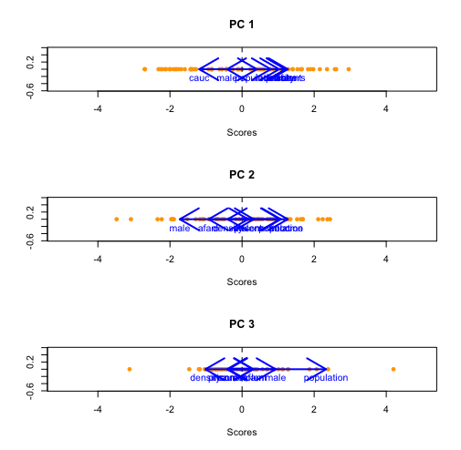
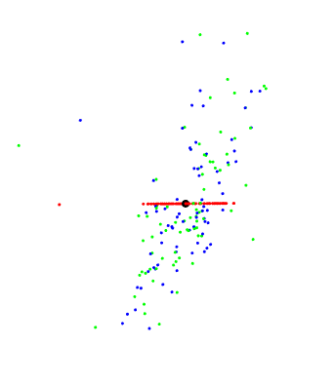
Figure 7
Figure 8
Each PCA shows the state-score
2D representation of states

Slide 18
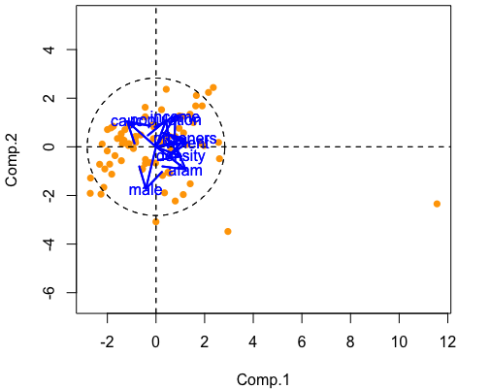
Combining the previous two plots we can see the distribution of each state related to PC 1 and 2
Figure 9

Slide 19
2.3.: Cluster-Analysis

Slide 20
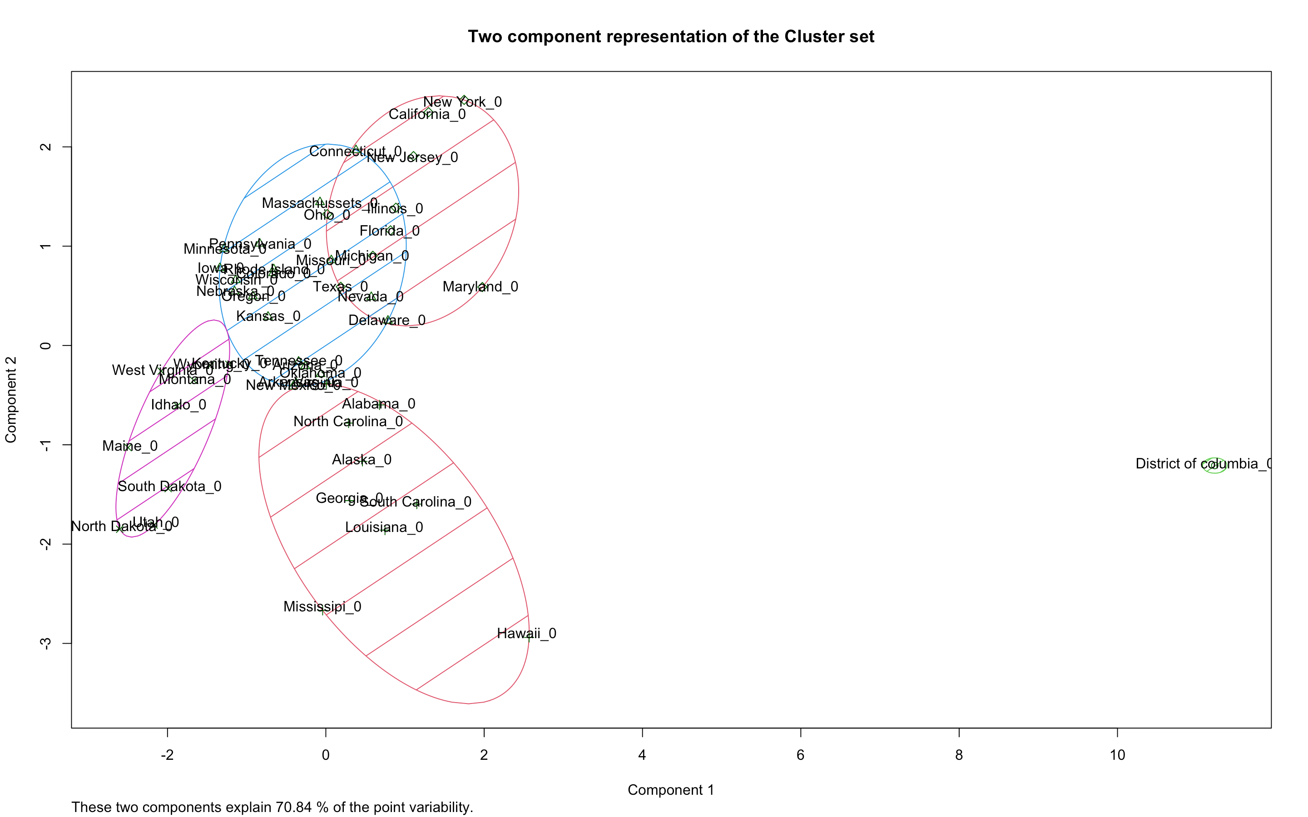
Figure 10
Representation of states in clusters without an effective gun law

Slide 21
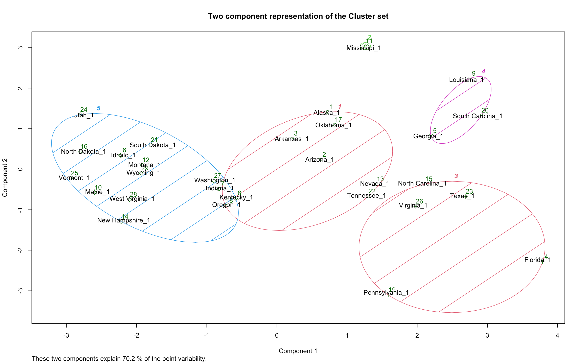
Figure 11
Representation of states in clusters with an effective gun law

Slide 22
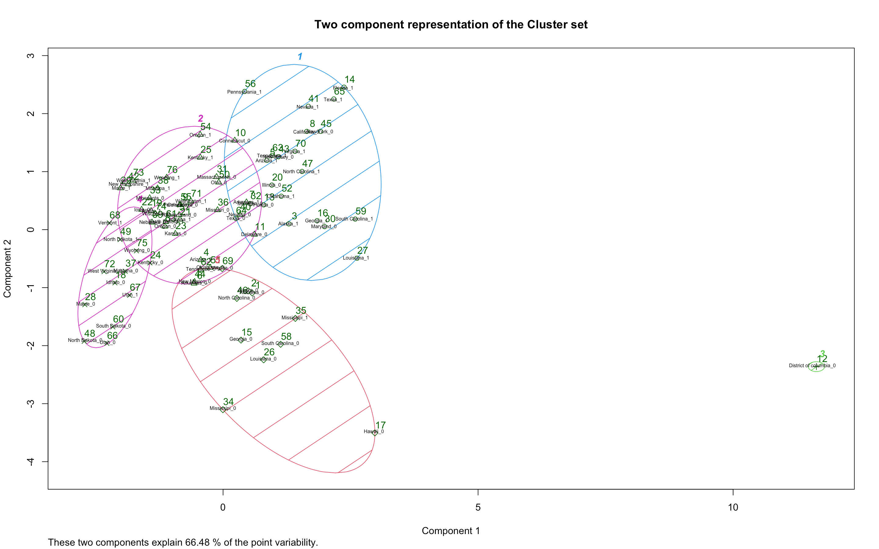
Figure 12
Representation of states in clusters with and without an effective gun law

Slide 23
3.: Conclusion
Violence rates differ greatly among the states but remain the same over time
Violence occurs more in states with higher population, more prisoners, higher percentage of different ethnicities and higher personal income
The cluster analysis shows that an effective gun law has an impact on violence rate

Slide 24
Thank you for your attention!

